Slide 1

Including file & Upload file in PHP

Slide 2
Objectives
Including file in PHP
Upload file in PHP

Slide 3
PHP Include Files
The include (or require) statement takes all the text/code/markup that exists in the specified file and copies it into the file that uses the include statement.
Including files is very useful when you want to include the same PHP, HTML, or text on multiple pages of a website.

Slide 4
PHP Include Files
It is possible to insert the content of one PHP file into another PHP file (before the server executes it), with the include or require statement.
The include and require statements are identical, except upon failure:
  require statement will produce a fatal error (E_COMPILE_ERROR) and stop the script
  include statement will only produce a warning (E_WARNING) and the script will continue

Slide 5
PHP Include Files
So, if you want the execution to go on and show users the output, even if the include file is missing, use the include statement.
Otherwise, in case of FrameWork, CMS, or a complex PHP application coding, always use the require statement to include a key file to the flow of execution.
This will help avoid compromising your application's security and integrity, just in-case one key file is accidentally missing.
Including files saves a lot of work. This means that you can create a standard header, footer, or menu file for all your web pages. Then, when the header needs to be updated, you can only update the header include file.

Slide 6
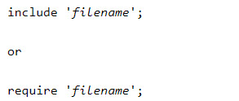
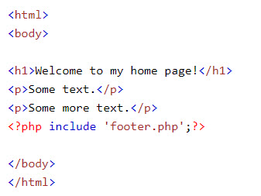
PHP Include Files
Syntax
Example

Slide 7
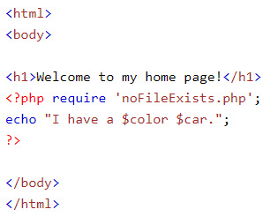
PHP include vs. require
The require statement is also used to include a file into the PHP code.
However, there is one big difference between include and require; when a file is included with the include statement and PHP cannot find it, the script will continue to execute, the require statement returned a fatal error

Slide 8
Demo
Teacher demo creating layout of web page by including files

Slide 9
PHP File Uploading
A PHP script can be used with a HTML form to allow users to upload files to the server. Initially files are uploaded into a temporary directory and then relocated to a target destination by a PHP script.
An uploaded file could be a text file or image file or any document.
The process of uploading a file follows these steps
  The user opens the page containing a HTML form featuring a text files, a browse button and a submit button.
  The user clicks the browse button and selects a file to upload from the local PC.
  The full path to the selected file appears in the text filed then the user clicks the submit button.
  The selected file is sent to the temporary directory on the server.
  The PHP script that was specified as the form handler in the form's action attribute checks that the file has arrived and then copies the file into an intended directory.
  The PHP script confirms the success to the user.

Slide 10
Creating an upload script
There is one global PHP variable called $_FILES. This variable is an associate double dimension array and keeps all the information related to uploaded file.
So if the value assigned to the input's name attribute in uploading form was file, then PHP would create following five variables
  $_FILES['file']['tmp_name'] − the uploaded file in the temporary directory on the web server.
  $_FILES['file']['name'] − the actual name of the uploaded file.
  $_FILES['file']['size'] − the size in bytes of the uploaded file.
  $_FILES['file']['type'] − the MIME type of the uploaded file.
  $_FILES['file']['error'] − the error code associated with this file upload.

Slide 11
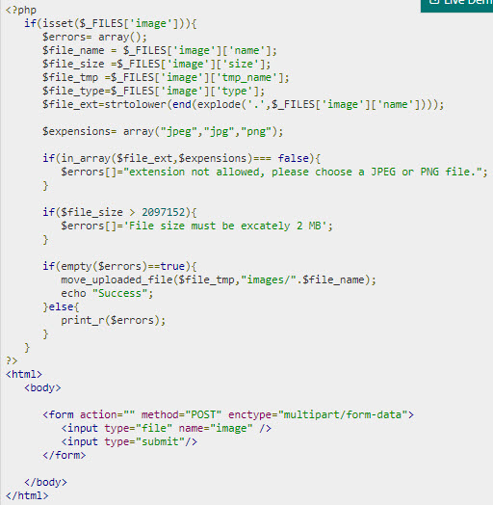
Example

Slide 12
PHP File Uploading
Some rules to follow for the HTML form above:
  Make sure that the form uses method="post"
  The form also needs the following attribute: enctype="multipart/form-data". It specifies which content-type to use when submitting the form
  Without the requirements above, the file upload will not work.
  The type="file" attribute of the <input> tag shows the input field as a file-select control, with a "Browse" button next to the input control

Slide 13
Demo
Teacher demo code about uploading file process for students.

